Slide 1


Bartering Books
Prepared By: Guided By:
Karan Bhatt(201803100810008) Ms. Vaibhavi Solanki
Kevin Mehta (201803100810074)
B.Tech. IT (7th Semester) Assistant Professor , DIT
CGPIT. CGPIT.

Slide 2
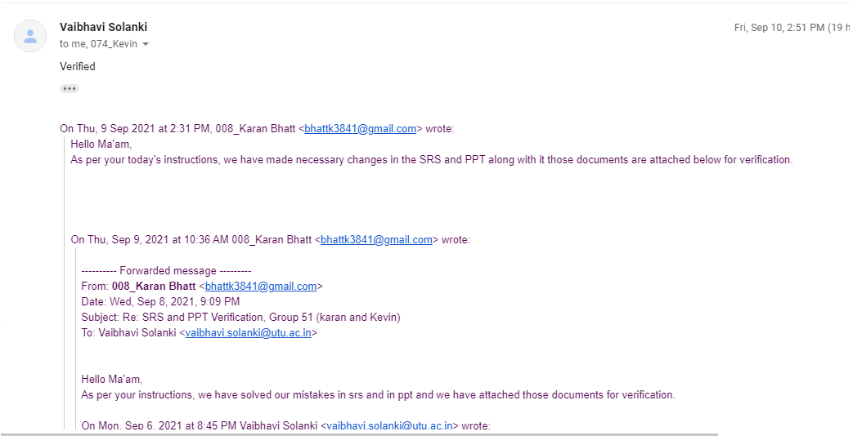
Consent from guide for this presentation
Bartering Books, CGPIT

Slide 3
Outline
Introduction
Motivation
Objective
Scope
Analysis for development
Modules
Diagrams
Technologies/Platform to be used for development
Implementation
Future work
Conclusion
References
Bartering Books, CGPIT

Slide 4
Introduction
Many individuals want to give away the books they no longer need.
Traditionally, they can either talk to their friends or have to look for the people who are in need via different connections.
These activities are time consuming and exhausting.
So this problem can be resolved using this platform.
Bartering Books, CGPIT

Slide 5
Motivation
Reason to select this topic is to provide free literacy and education in the society.
With the help of this platform the people with low income and with real needs can get benefited.
In today’s time the cost to produce a single books has increased and also a large number of trees are cut for it , so this platform will help to overcome those problems.
Bartering Books, CGPIT

Slide 6
Objective
As the name of the project suggests, aim here is to create a platform for book lovers.
Purpose behind this website is to provide a single platform to those users who do not want to spend or do not have sufficient amount of money to spend on books.
This website will provides an inexpensive way for such people to exchange books, find out about new books and obtain a new book to read at free of cost.
Bartering Books, CGPIT

Slide 7
Scope
Website hopes to have audience who are in search of books. There are no restriction criteria for audience as of now.
  Audience can be kids who are beginners or youngsters who already has fond of reading.
  Audience can be a person who intends to exchange his book or he/she can be a person who wants to explore new books and also who wants to donate their old books.
Bartering Books CGPIT

Slide 8

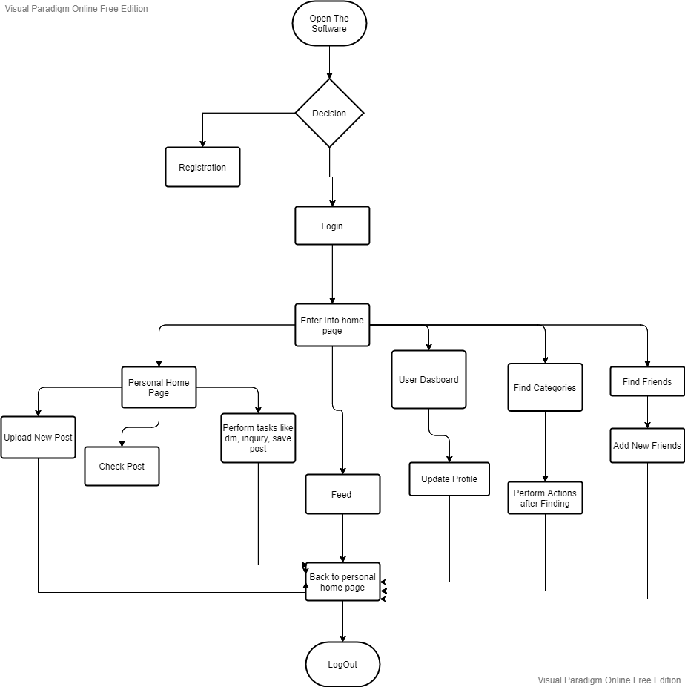
Analysis for development
Bartering Books, CGPIT

Slide 9
Modules
Authentication Module:- Registration, Login, Logout.
Location Access:- Feed Generation According to location.
Home page:- posts , filter (different genre of books), save, search, direct message.
Leader Board:- Top users and exchangers are listed and provided rewards accordingly.
Feed:- Different posts from different users can be visible even if not following.
User Dashboard:- Profile, followers, posts, points
Bartering Books, CGPIT

Slide 10
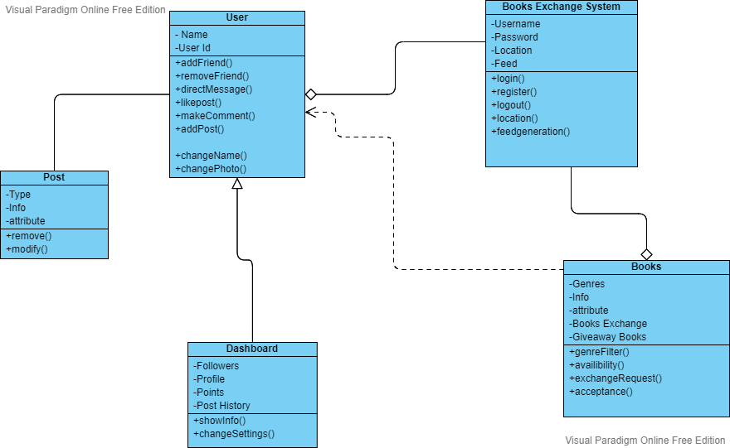
Class Diagram
Bartering Books, CGPIT

Slide 11
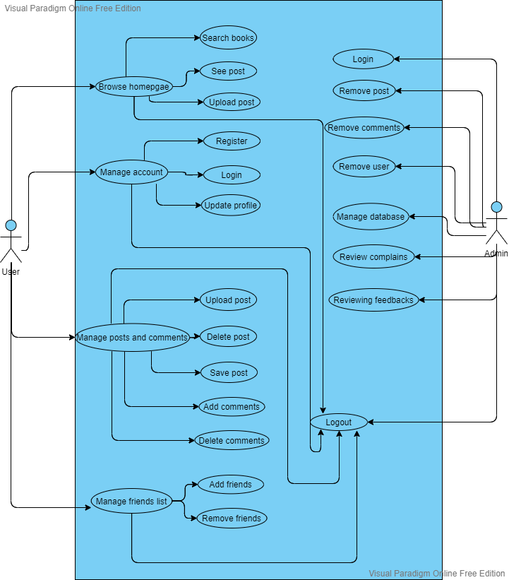
Use Case Diagram
Bartering Books, CGPIT

Slide 12
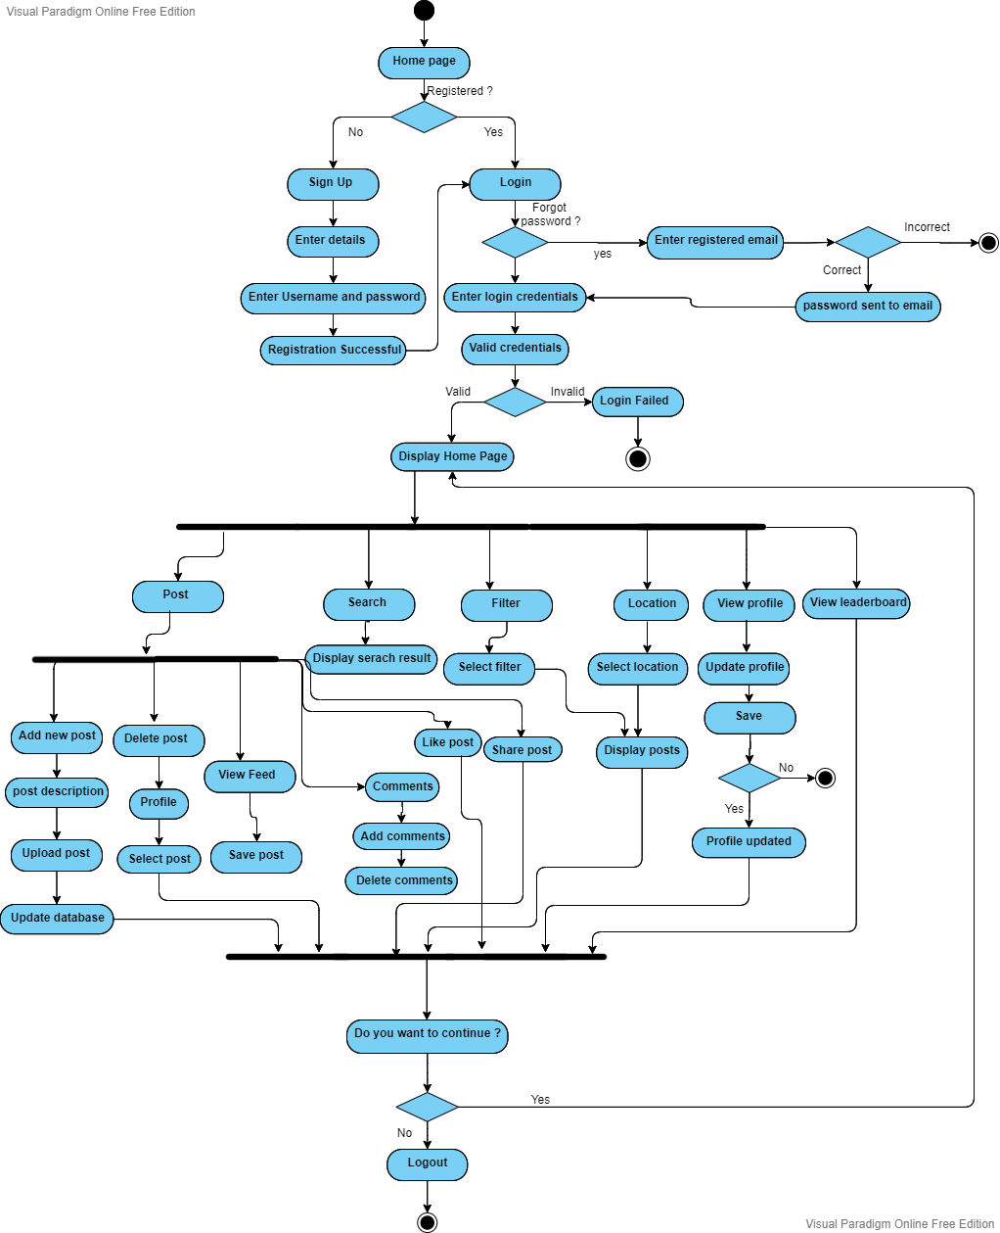
Activity Diagram
Bartering Books, CGPIT

Slide 13
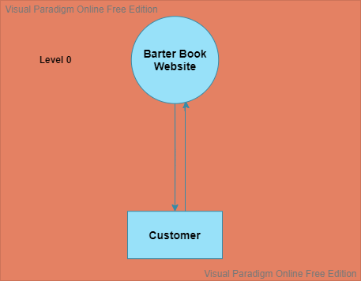
Data Flow Diagram(DFD)
Bartering Books, CGPIT

Slide 14
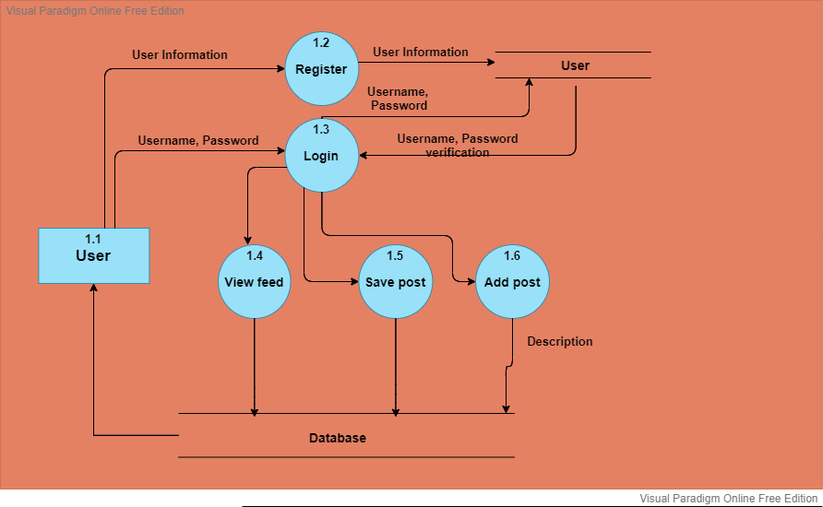
Bartering Books, CGPIT

Slide 15
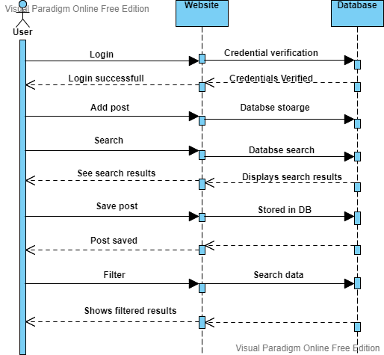
Sequence Diagram
Bartering Books, CGPIT

Slide 16
Technologies/Platform to be used for development
Front end:- Django, HTML, CSS, Javascript, Jquery, Bootstarp.
Back end:- Django, PostgreSQL.
Technology:- Django Web Server.
Bartering Books, CGPIT

Slide 17
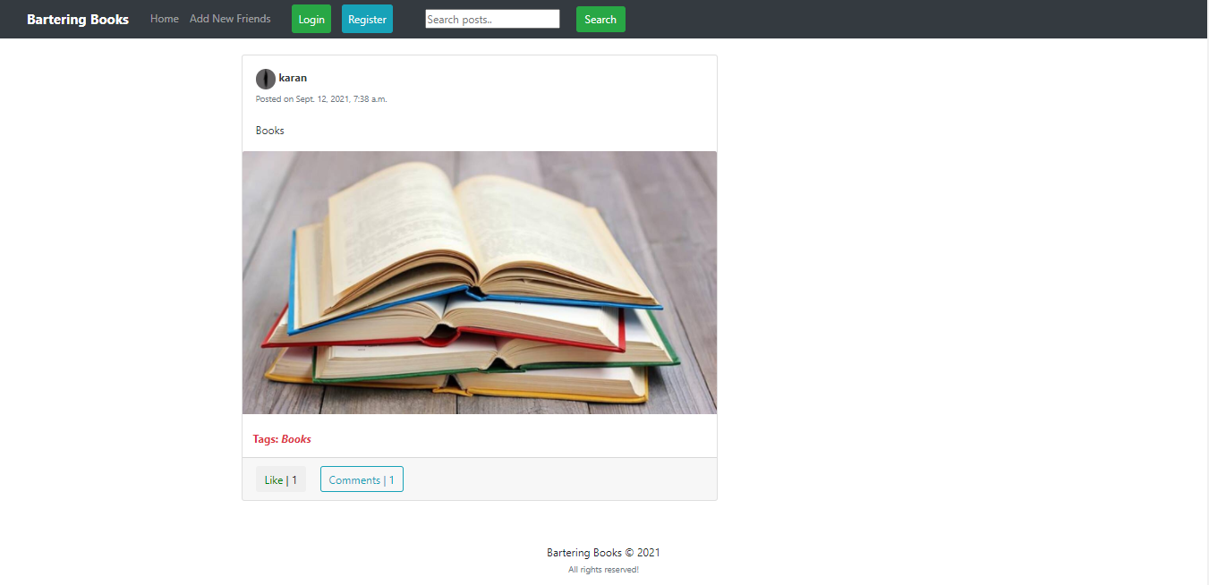
Implementation
Home Page
Project Title, CGPIT

Slide 18
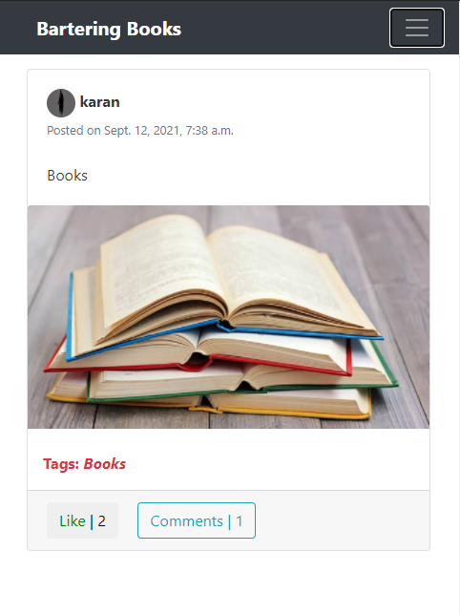
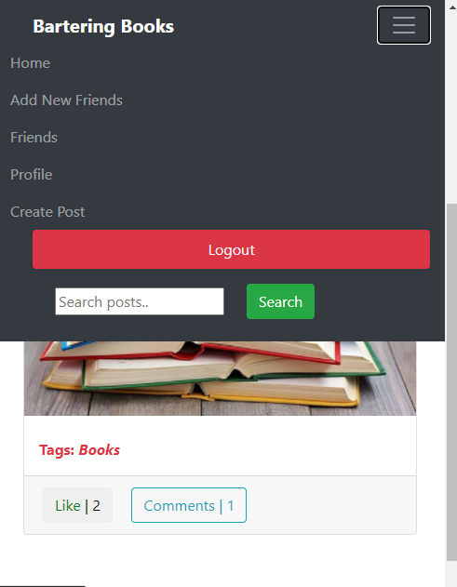
Implementation
Mobile view.
Project Title, CGPIT

Slide 19
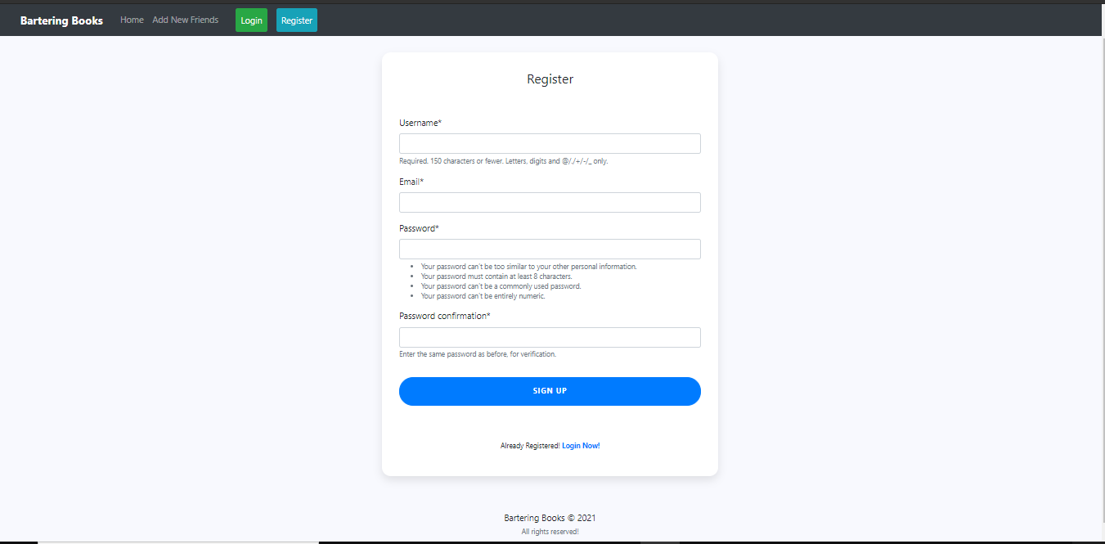
Implementation
Register
Project Title, CGPIT

Slide 20
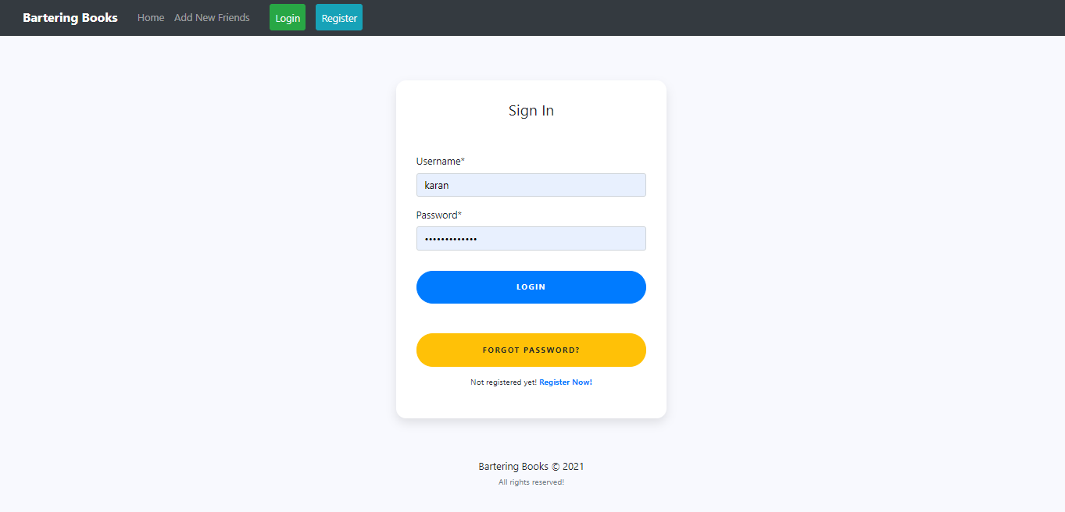
Implementation
Login
Project Title, CGPIT

Slide 21
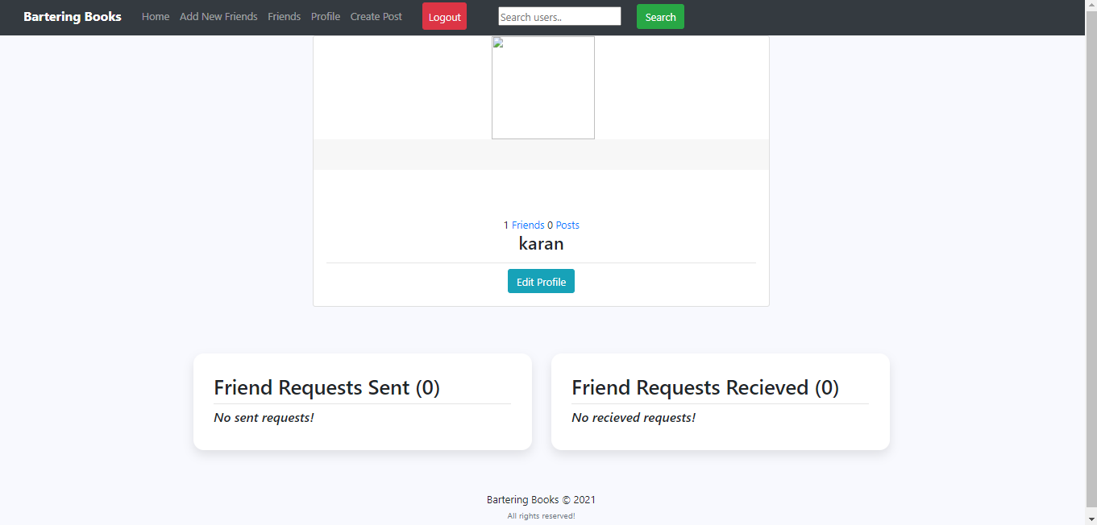
Implementation
Profile
Project Title, CGPIT

Slide 22
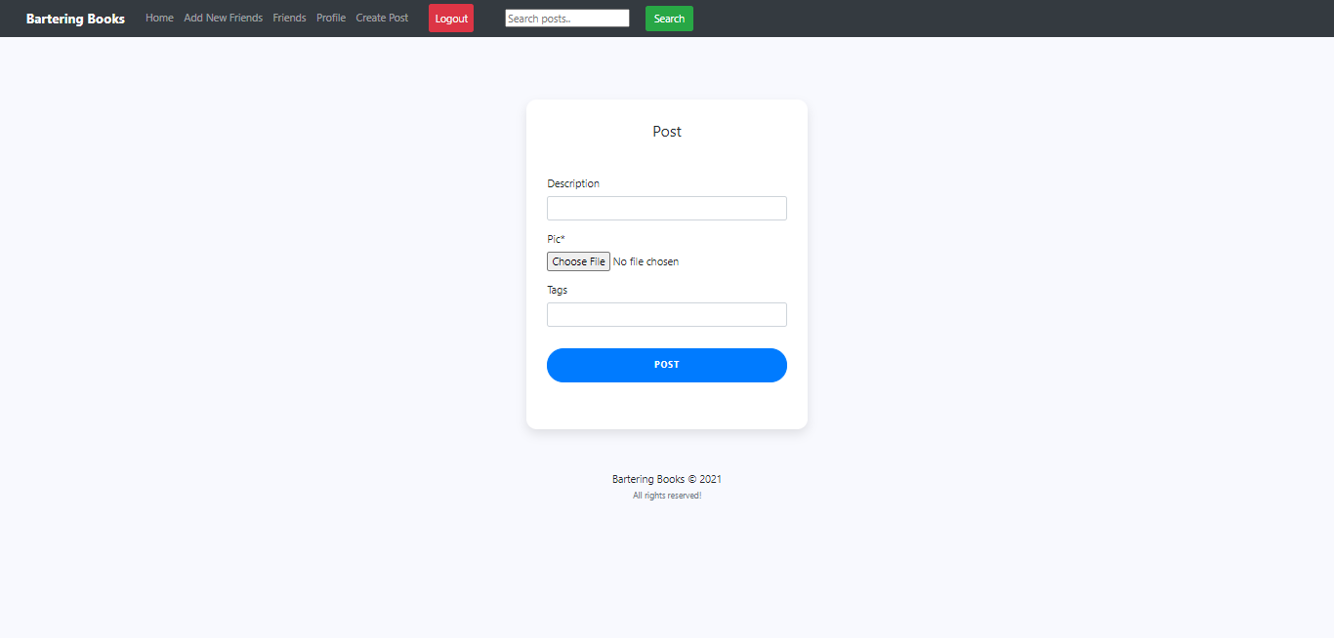
Implementation
Uploading post
Project Title, CGPIT

Slide 23
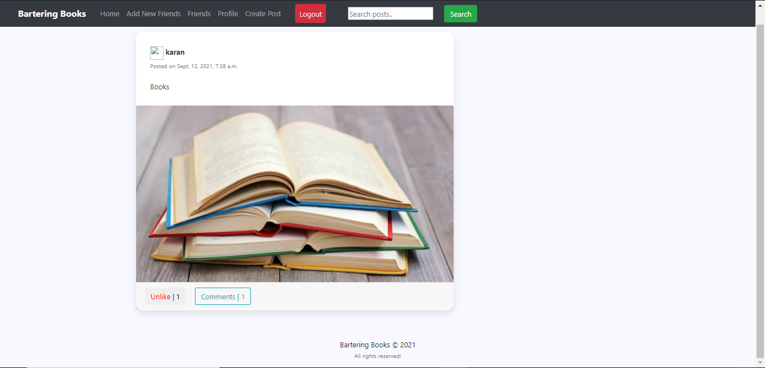
Implementation
Project Title, CGPIT

Slide 24
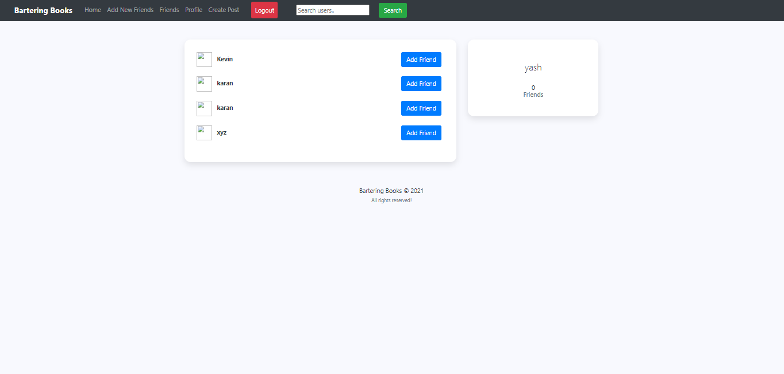
Implementation
Add Friends
Project Title, CGPIT

Slide 25
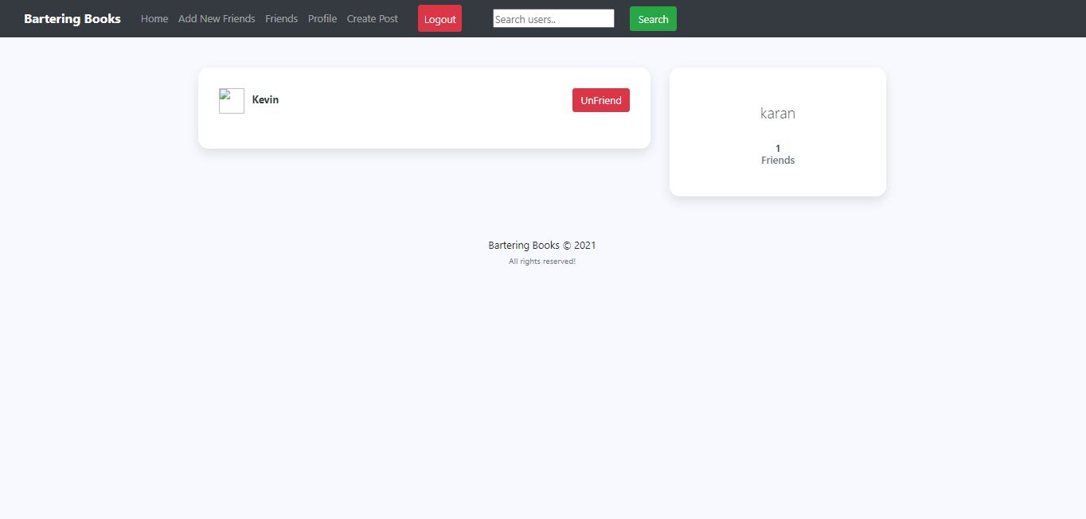
Implementation
Friends list
Project Title, CGPIT

Slide 26
Implementation
Databases
Table Name | Description
Feed_comments | It store comments done in pots.
Feed_like | It stores the like details of the post.
Feed_post | It store posts.
Users_friendrequest | It stores details about friend request sent, accepted, and rejected.
Users_profile | It stores user profile information.
Users_profile_friends | It stores the list of friends in a users profile.
Project Title, CGPIT

Slide 27
Future work
In future following modules will be implemented:-
Leader Board
Location
Bartering Books, CGPIT

Slide 28
Conclusion
To summarize the overall presentation, we have completed the necessary requirement gathering related to our project.
Also, the documentation needed for the project describing its understanding has been illustrated and we have begin with the implementation part.
Bartering Books, CGPIT

Slide 29
References
[online]https://docs.djangoproject.com/en/3.2/ [Date of Access:20-08-2021]
[online]https://www.bookcrossing.com/[Date of Access:22-08-2021]
[online]https://ndl.iitkgp.ac.in/[Date of Access:22-08-2021]
[online]https://www.mypustak.com/[Date of Access:27-08-2021]
Bartering Books, CGPIT

Slide 30
Thank You
Bartering Books, CGPIT

